Slide 1



POWERPOINT PRESENTATION FOR CA1
NAME- ARPAN KUMAR SINGH
ROLL-13000120041
SUB-PEC-CS701E
TOPIC - AI

Slide 2


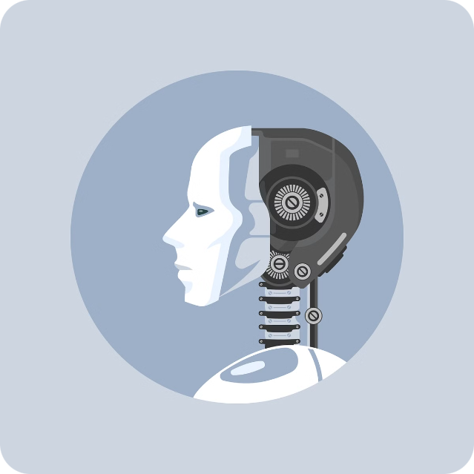

Artificial Intelligence: A Journey into the Future
Artificial intelligence (AI) is a rapidly evolving field that encompasses the development of intelligent machines capable of performing tasks that typically require human intelligence.
by ARPAN KUMAR SINGH

Slide 3
Defining AI: Capabilities and Limitations
Capabilities
Limitations
AI systems are adept at tasks such as image recognition, natural language processing, and decision-making. AI is also being used in industries such as healthcare, finance, and transportation.
Despite its advancements, AI still struggles with complex tasks requiring common sense and creativity. AI systems are often limited by their reliance on large datasets and lack of adaptability in novel situations.

Slide 4

Machine Learning: Algorithms and Applications
1
Supervised Learning
2
Unsupervised Learning
3
Reinforcement Learning
This involves training models on labeled data to predict outcomes. Examples include image classification and spam filtering.
This aims to discover patterns and insights from unlabeled data. Examples include customer segmentation and anomaly detection.
This involves training agents to learn through trial and error, interacting with an environment to maximize rewards. Examples include game playing and robotics.

Slide 5

Natural Language Processing: Chatbots and Language Understanding
Text Analysis
Voice Assistants
NLP involves analyzing text data to extract meaning and sentiment, enabling tasks like document summarization and translation.
Voice assistants like Siri and Alexa use NLP to understand spoken commands and respond accordingly, revolutionizing how we interact with technology.
1
2
3
Chatbots
Chatbots are AI-powered conversational agents that simulate human interaction, providing customer service or assistance in various domains.

Slide 6
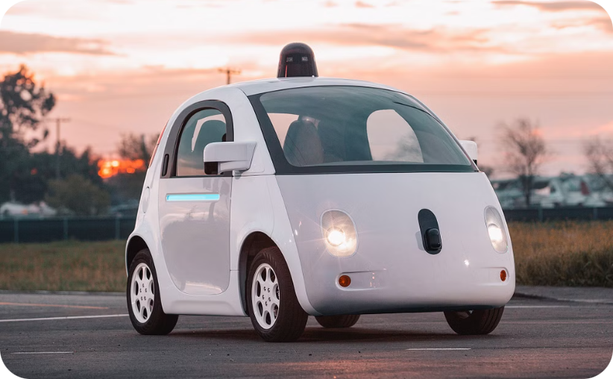
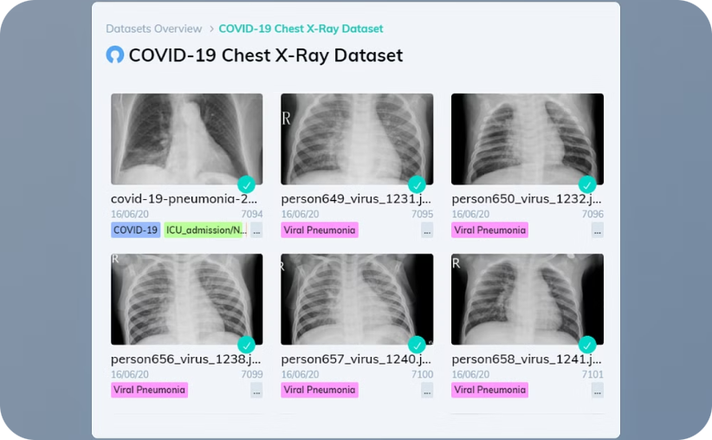
Computer Vision: Image and Video Analysis
Autonomous Vehicles
Medical Diagnosis
Computer vision enables self-driving cars to perceive their surroundings, navigate roads, and avoid obstacles.
Computer vision assists doctors in diagnosing diseases by analyzing medical images, such as X-rays and MRIs.

Slide 7

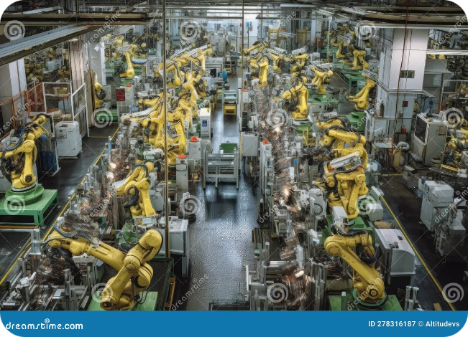



Robotics and Autonomous Systems
Industrial Automation
Robots are increasingly employed in factories to perform repetitive tasks, improving efficiency and reducing human error.
Healthcare Assistance
Robots are used in healthcare for tasks like surgery, rehabilitation, and medication delivery, enhancing patient care and precision.
Exploration and Research
Robots are crucial for exploring dangerous environments, such as deep-sea trenches or outer space, where human presence is risky.

Slide 8

Ethical Considerations in AI
Bias and Discrimination
AI algorithms can perpetuate biases present in training data, leading to unfair outcomes.
Privacy and Security
AI applications often require access to sensitive data, raising concerns about privacy and data breaches.
Job Displacement
The increasing use of AI in automation raises concerns about job displacement and the need for workforce retraining.

Slide 9


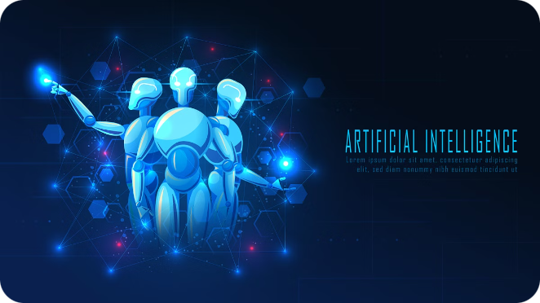


The Future of Artificial Intelligence
Cognitive Computing
AI will continue to advance, pushing the boundaries of human intelligence and enabling computers to solve complex problems.
Human-Robot Collaboration
AI will augment human capabilities, leading to partnerships between humans and robots in various domains, such as healthcare and manufacturing.
AI for Social Good
AI will be used to address global challenges such as climate change, poverty, and disease, leveraging its power for positive impact.

